Slide 1
Category review: Chips
June 2020
Retail Analytics
Brand note: If client logo is not required, use alternate title page layout right click slide thumbnail > Layout > Title

Slide 2
Notes:
To view Privacy video explaining how important data privacy is to Quantium, please click here: https://www.youtube.com/watch?v=Zq1QDAkoRzU
or here Q:\Company Reference\Brand & Design\Brand videos\Q Privacy.mp4
At Quantium, we believe that data is the behavioural footprint of humanity and that it has to be treated with the utmost care and responsibility.
Histories, attitudes, indeed lives are stored within it in ways that aren’t always apparent – and that’s what makes its potential so powerful.
To work with it responsibly, sensitively, we set ourselves the highest data privacy protection and governance standards.
We have spent 17 years perfecting privacy-by-design and secure-by-design principles. Central to this is not holding any personally identifiable information about people –
we neither receive it, and put the necessary protections in place to be unable to decipher it.
Every aspect of handling data is safeguarded: from its de-identification, to its encryption – data security is paramount and of the highest grade.
We pride ourselves on gaining the trust of iconic organisations around the world through years of securely working with their data,
and in turn the trust that builds with their stakeholders.

Slide 3
Executive summary
01
Task 1
- Highest sales period is during December
- Top three popular brands is Kettle Chips, Smiths and Doritos
- Older families with budget purchasing behaviour represent the highest proportion of customers
- Older families with budget purhcasing behaviour contribute the highest proportion of total sales
- Older families with mainstream purchasing behaviour buy the most chips on average
- Young singles/couples with mainstream purchasing behaviour buy the chips with the highest price on average.
02
Task 2
- Store 77
-sales are lower than control store during the trial period
- sales are higher during trial period than rest of year
- Store 86
- sales are lower than control store during the trial period
- sales are higher during trial period than rest of year
- Store 88
- sales are higher than control store during the trial period
- sales are higher during trial period than rest of year

Slide 4
01
Brands Analysis

Slide 5
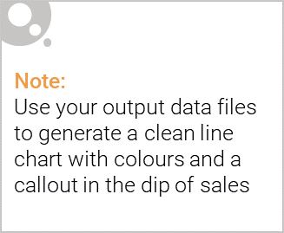
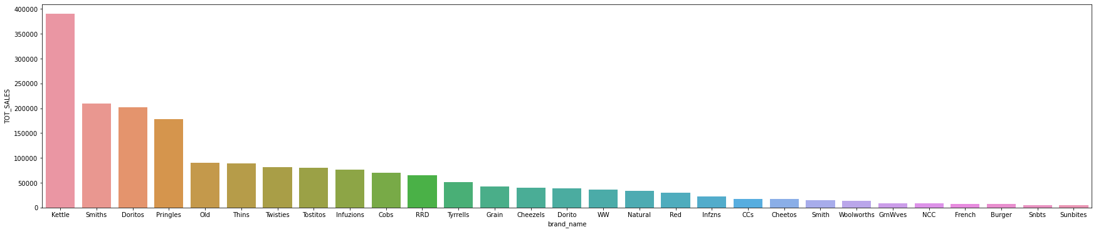
Most Popular Brands based on Sales

Slide 6

Affluence and its effect on consumer buying for the category of chips
Kettle is the most popular brand followed by Smiths, Doritos and Pringles.
Mainstream young singles/couples, retirees are the most common customers and also account for a great share of chips sale.
Budget older families have the maximum contribution to sales.
Mainstream young singles/couples and mid-age single/couples pay more per packet than any other group.

Slide 7
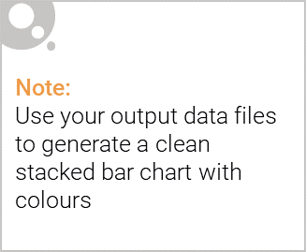
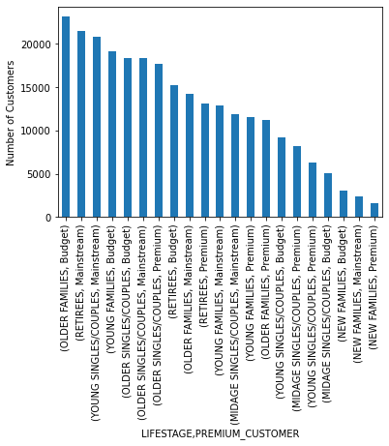
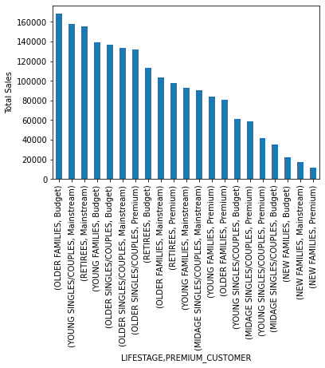
Editable (delete this)
Visualising the proportion of customers by affluence and life stage on this slide

Slide 8
02
Trial store performance

Slide 9
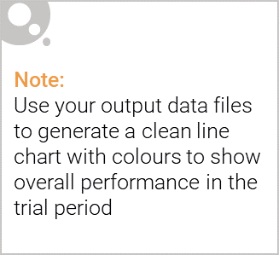
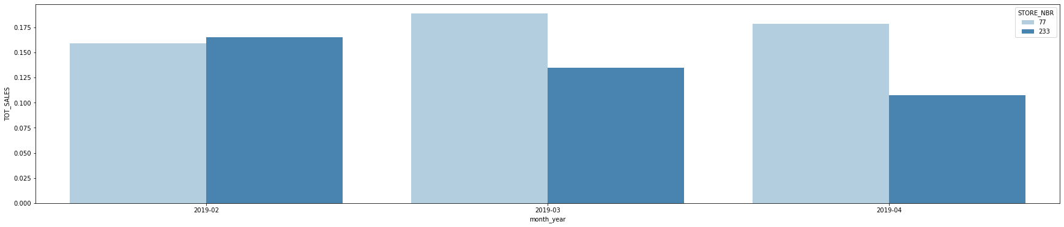
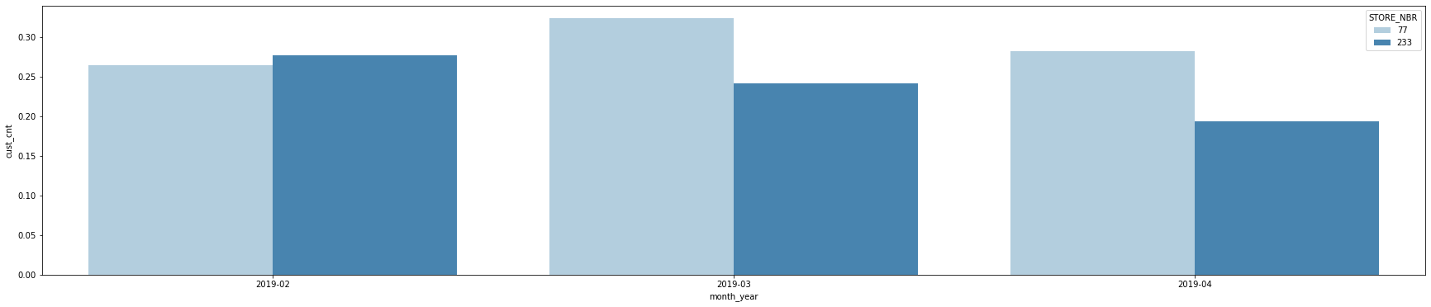
Explanation of the control store vs Store 77

Slide 10
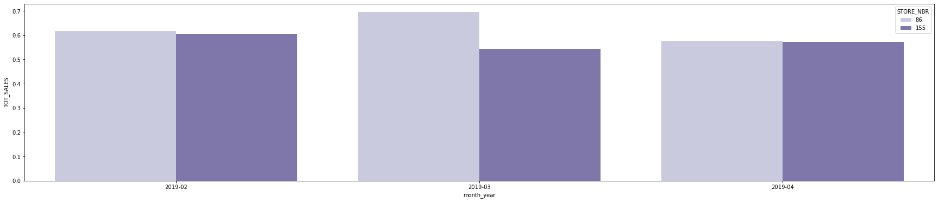
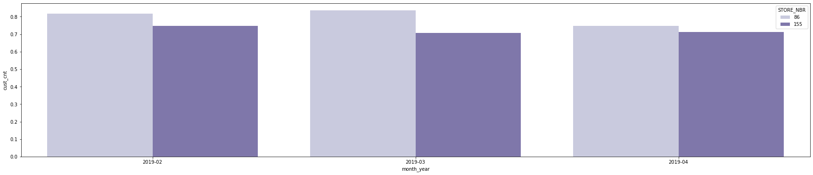
Explanation of the control store vs Store 86

Slide 11
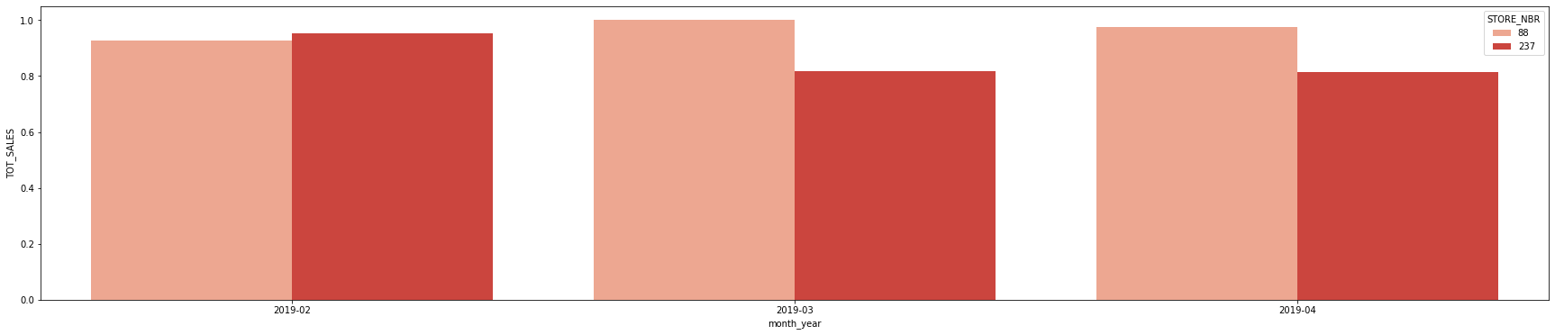
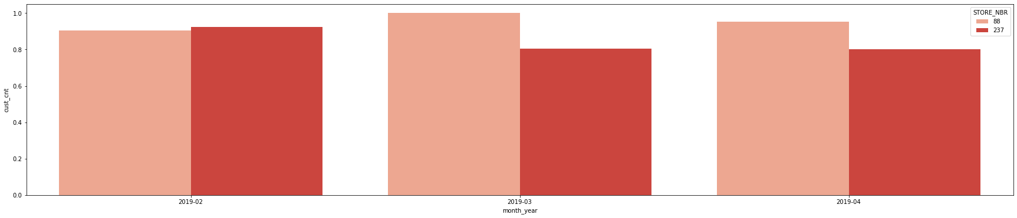
Explanation of the control store vs Store 88

Slide 12
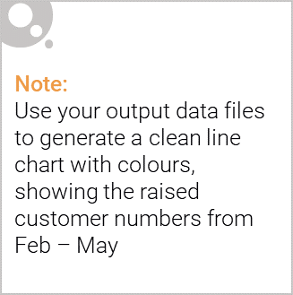
Call out of the performance in the trial store, determining if it was successful
- Store 77
-sales are lower than control store during the trial period
- sales are higher during trial period than rest of year
- Store 86
- sales are lower than control store during the trial period
- sales are higher during trial period than rest of year
- Store 88
- sales are higher than control store during the trial period
- sales are higher during trial period than rest of year

